Slide 1
Automatic Creation Of Voting Districts
William Austin
CS 633, Fall 2019

Slide 2
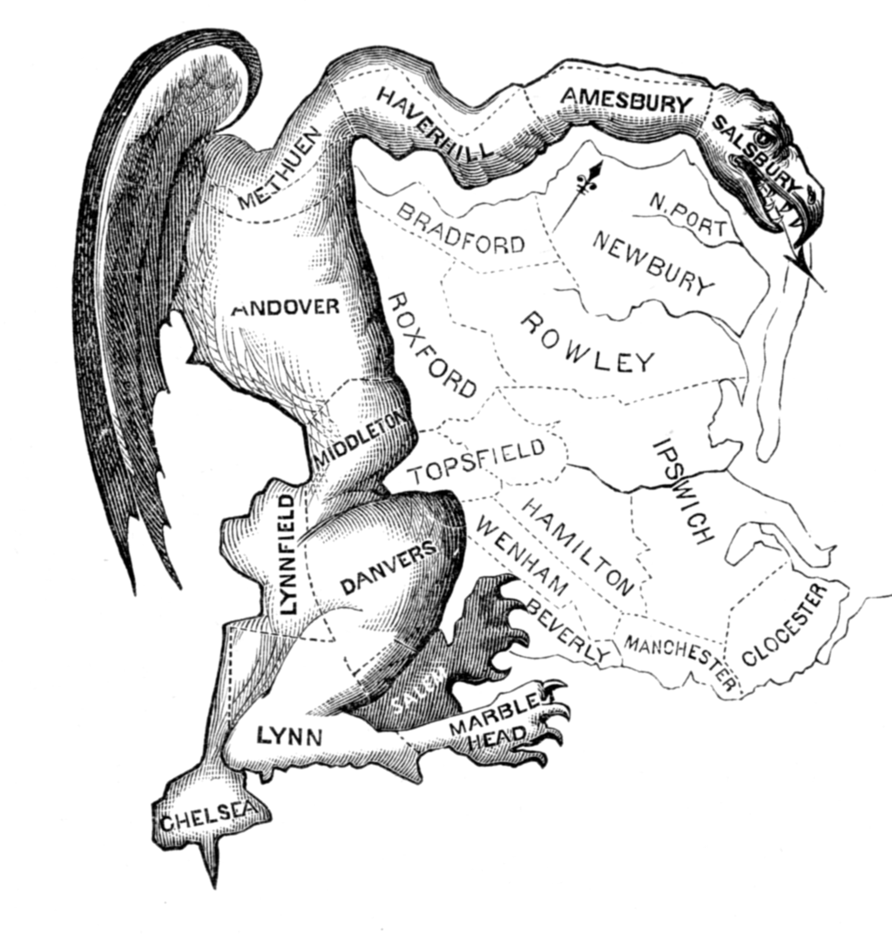
What is “Gerrymandering”?
Simply stated, “gerrymandering” is the process of manipulating electoral district boundaries for political advantage.
Sometimes referred to as “packing and cracking” or “politicians picking their voters instead of the voters picking their politicians”.
The “Gerry-Mander”, an 1812 Boston Gazette political cartoon which pokes fun at the districts signed into law by Massachusetts Governor Elbridge Gerry

Slide 3
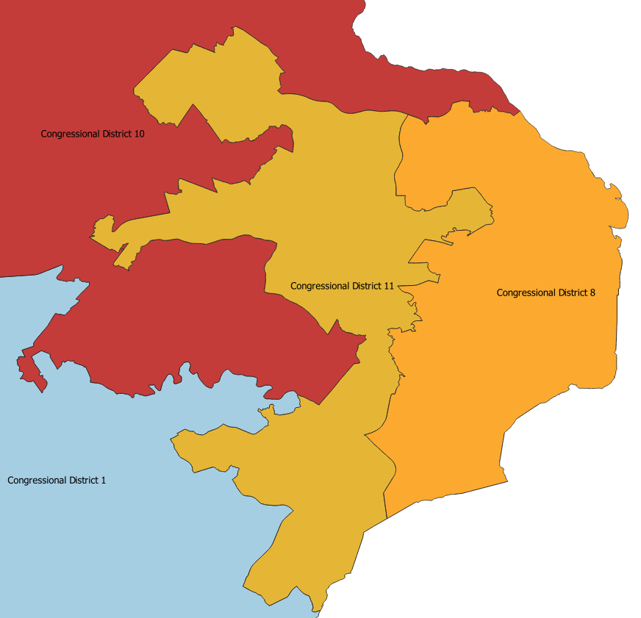
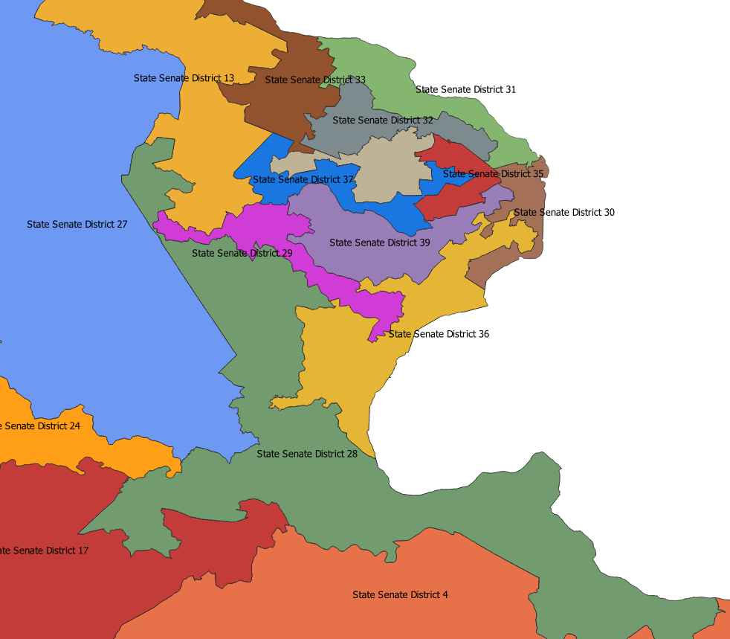
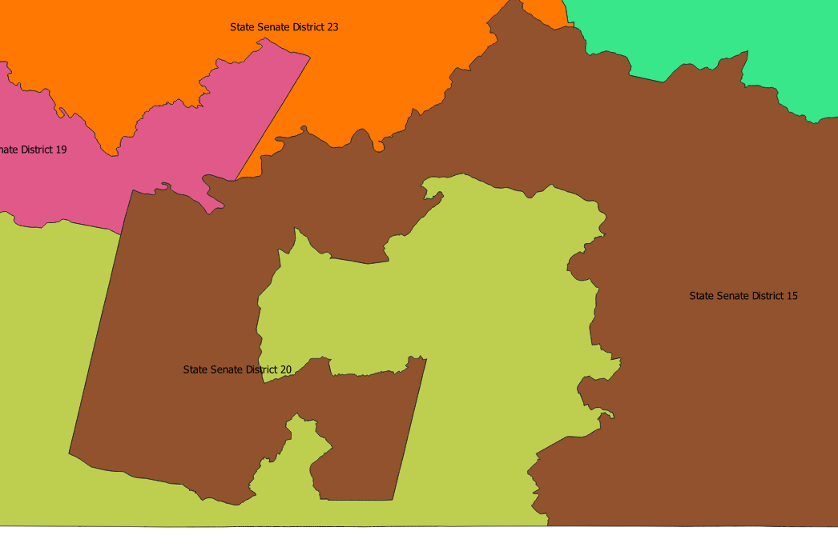
Some Examples from Virginia
Congressional District 11
State Senate District 28
State Senate Districts 15 & 20

Slide 4


Recent Developments (since 2000)
In the past 20 years, gerrymandering has become a larger issue because data and computational power has become more accessible.
Bipartisan support for combatting issues relating to gerrymandering has arisen across the U.S. Some of the strategies being employed are:
Creation of independent redistricting commissions to remove the political bias from the process
Use the Court system to strike down poorly drawn maps and set a legal precedent for what acceptable districts should look like.
OneVirginia2021 is the leading organization advocating for bipartisan redistricting reform in Virginia by amending the state constitution to require an independent commission
FairVote.org is a national organization promoting fair elections. They sponsored a district map drawing competition in 2011.
Brian Olson is a pioneer in this field and has been extremely active by creating software that automatically draws maps, running a redistricting website, and giving TED talks.

Slide 5

Project Goals
While doing this project, I had 3 main goals:
Analyze the work from the authors of the 2018 paper: “Balanced Power Diagrams for Redistricting” (Vincent Cohen-Addad, Philip N. Klein, and Neal E. Young). Use their implementation to reproduce their work for Virginia maps. Virginia was not one of the states the original paper had a map for.
Create maps for Congress, the VA State Senate and the VA House of Delegates.
Expand the original work to make maps more useful by modifying the output so that the electoral district boundaries are sensitive to existing census blocks.
Investigate metrics for compactness and create scripts to perform calculations on the original and updated maps.

Slide 6



Technology & Software
Product & Version | Usage
C++ 11 | Implementation of balanced power diagrams
Python 3.7.2 | Data formatting and processing scripts
Shapely 1.6.4 | Performing computations on polygons.
Pyshp 2.1.0 | Programmatically read and write shapefiles
PyProj 2.4.2 | Cartographic Projections
QGIS 3.10 | Manipulate geospatial data
gnuplot 5.2 | Generate map images

Slide 7
Steps for Creating Maps
Data Collection for Virginia
1
Find applicable shapefile and population datasets
Format Population and Census Block Data for Algorithm
2
Run Application to Create Maps for Virginia
3
Use Map Output to Create Standard Shapefiles
4
Generate District Maps Without splitting Census Blocks
5

Slide 8
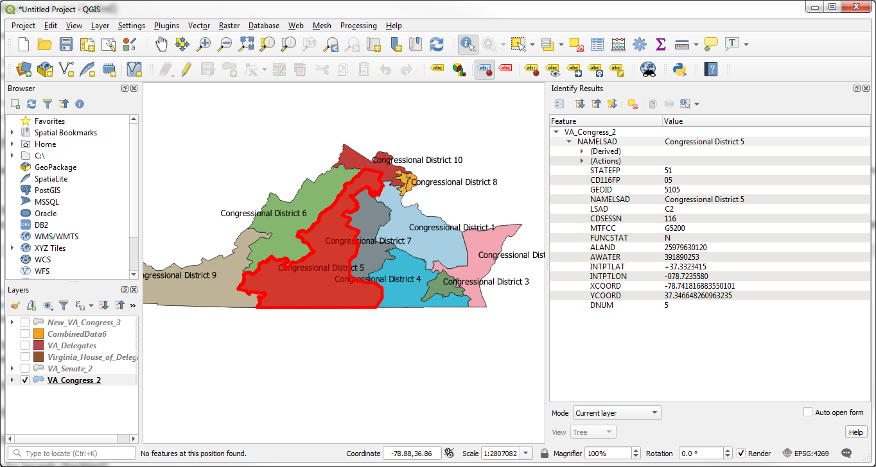
Step 1. Data Collection for Virginia
Shapefiles are relatively easy to find. I was able to download shapefiles from:
The US Census FTP site.
Several repositories, such as the VA Public Access Project
The VA Department of Elections
The VDOT website
Population data is a bit harder to find, but it can be downloaded from the American FactFinder website (run by the Census bureau).
When working with geospatial information, working with the available tools and understanding their capabilities is very important.
I went through a learning curve with this project.
Virginia Congressional Map in QGIS

Slide 9
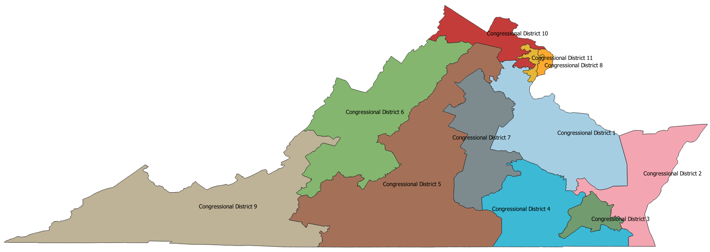
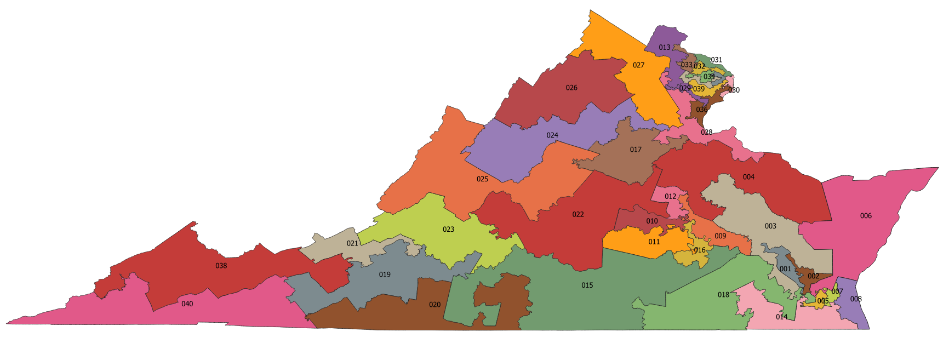
Step 1: Sample Starting Maps
Above: Current Virginia Congressional Districts
Below: Current Virginia State Senate Districts

Slide 10
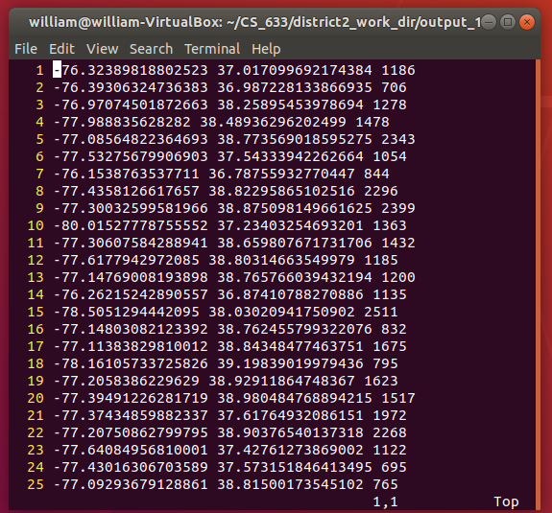
Step 2: Format Population and Census Block Data for Algorithm
Formatting the data required 2 main activities.
The population data and the shapefile from the previous step were not linked. The smallest unit of population available is the Census Block, so I had to perform a “geospatial join” to create a single data source. This can be done inside of QGIS by merging a vector layer (the census block data) with a data layer (the population CSV). The common field is the GEOID of the blocks.
Create a list of weighted points (longitude / latitude) for the Weighted Centroidal Voronoi Algorithm. I used Python to extract the population data and compute the centroid of each census block. There are 5301 non-empty census blocks in Virginia.

Slide 11
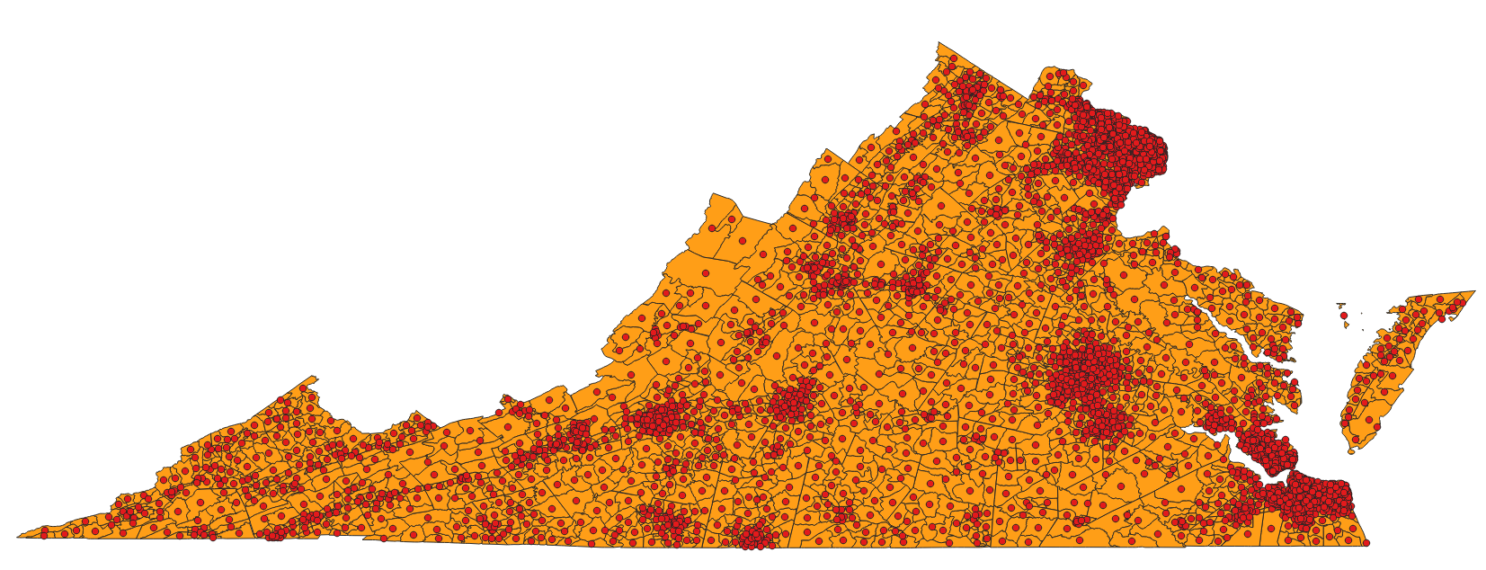
Step 2: Census Blocks with Centroids

Slide 12
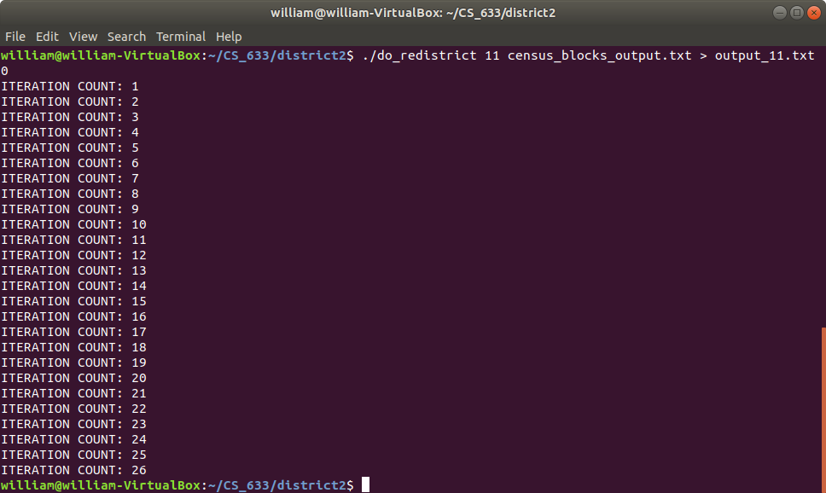
Step 3: Run Application to Create Maps for Virginia
The software written to compute the Balanced Centroidal Power Diagrams is available in the author’s Bitbucket repository, which I cloned to my Github account. The URL is:
https://github.com/william-r-austin/district2
I checked out the code (C++ and Python) and compiled it on my Ubuntu 18.04 VM. A few changes were required for compilation, but the functionality was complete, and the documentation was sufficient to reproduce the necessary steps.
Sample redistricting output for k = 11, with 5301 population centers. This runs in about 5 seconds.

Slide 13
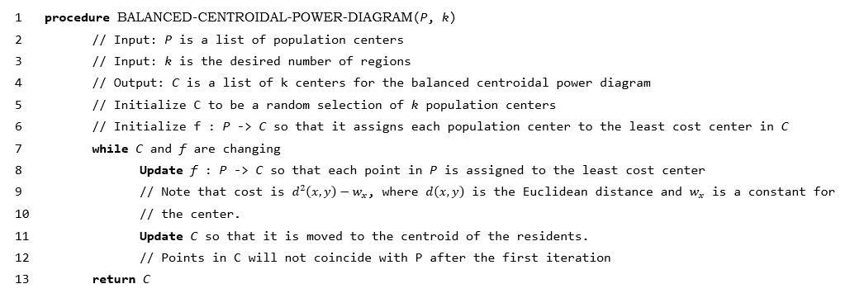
Step 3: Pseudocode for Balanced Centroidal Power Diagrams

Slide 14
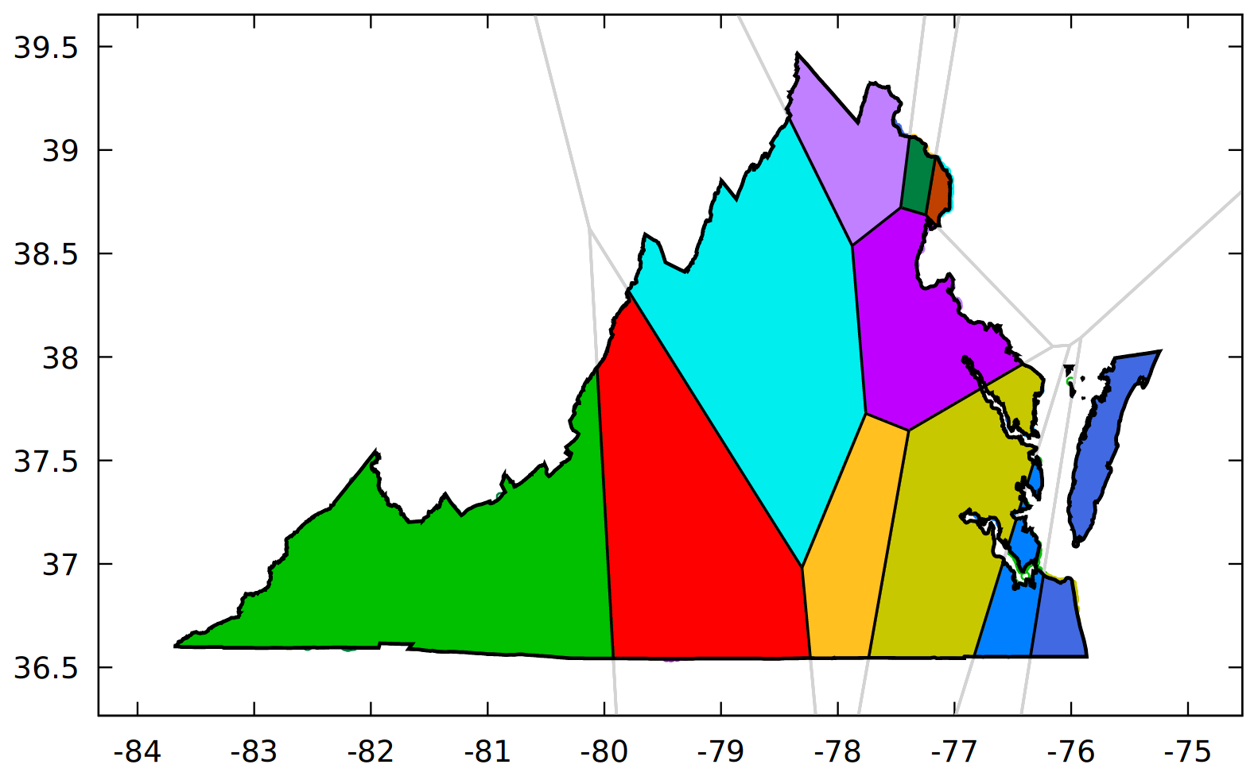
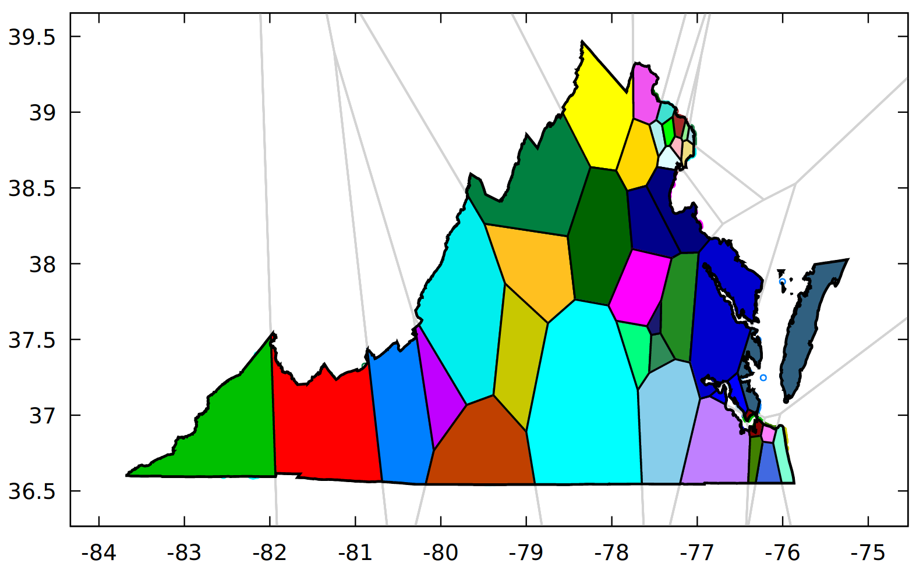
Step 3: Sample Output for Two Maps Congressional Districts
Congressional Districts (k = 11)
State Senate Districts (k = 40)

Slide 15
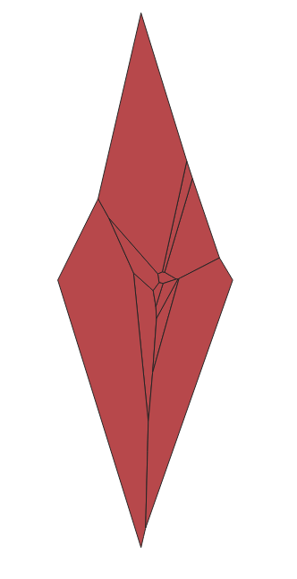
Step 4: Use Map Output to Create Shapefiles
Unfortunately, the existing code that produces the output above does not create a shapefile for us. Instead, it uses gnuplot to create an image that is embedded in a PDF file.
However, there are several steps that we can use to get what we want. This includes:
Use the raw output data to build a shapefile for the generated Voronoi cells. This step uses Python to read the raw text file and utilizes the PyShp library in to write the file for us.

Slide 16
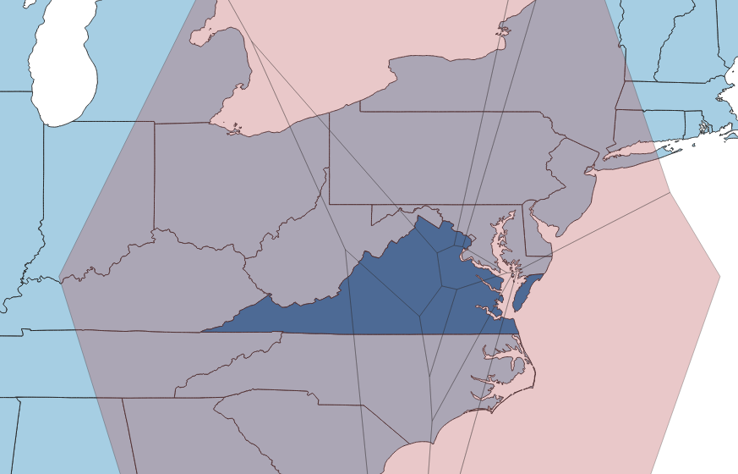
Step 4, Continued: Merge output
Merge the Voronoi output with a map of Virginia. You can see the Voronoi regions look identical to the previous image.
This operation can be easily performed in QGIS, once the proper shapefiles exist.

Slide 17
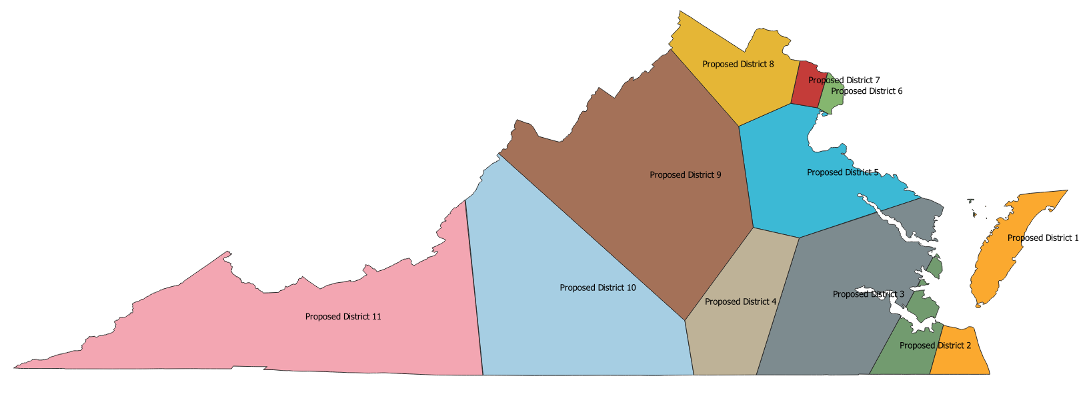
Step 4: Intersect and Cleanup
Use QGIS to perform the following steps:
Perform an intersection function that breaks overlapping features into individual features.
Remove any features that did not intersect with the Virginia record. (This could also be done first)
Clean up the map and add labels and coloring.

Slide 18
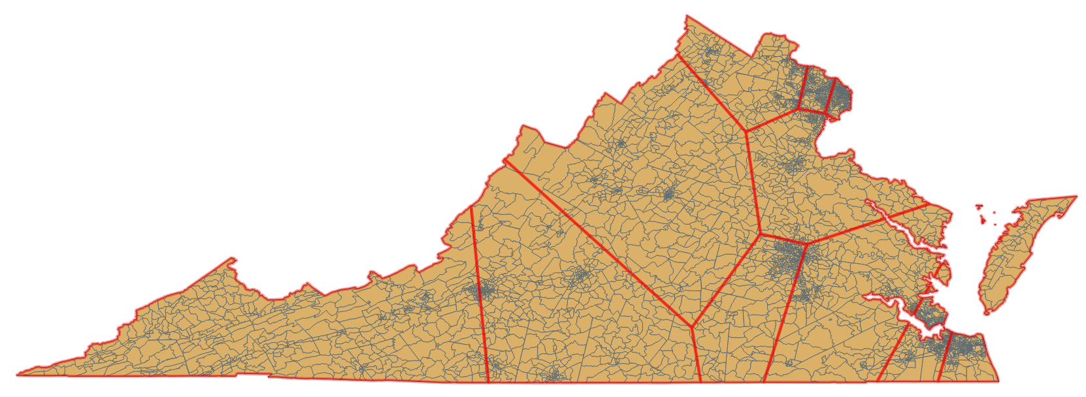
Step 5: Generate District Maps without Splitting Census Blocks
In this step we use the output from Step 4 and perform an additional transformation to make sure that census blocks are kept intact.
We use a Python script that iterates over all of the census blocks from Step 4 and assigns it to the district that it has the largest overlap with. Used a self created index to max this fast!!
We need to be especially careful doing this because both the districts and the census blocks may have multiple components. See District 1 for an example.

Slide 19
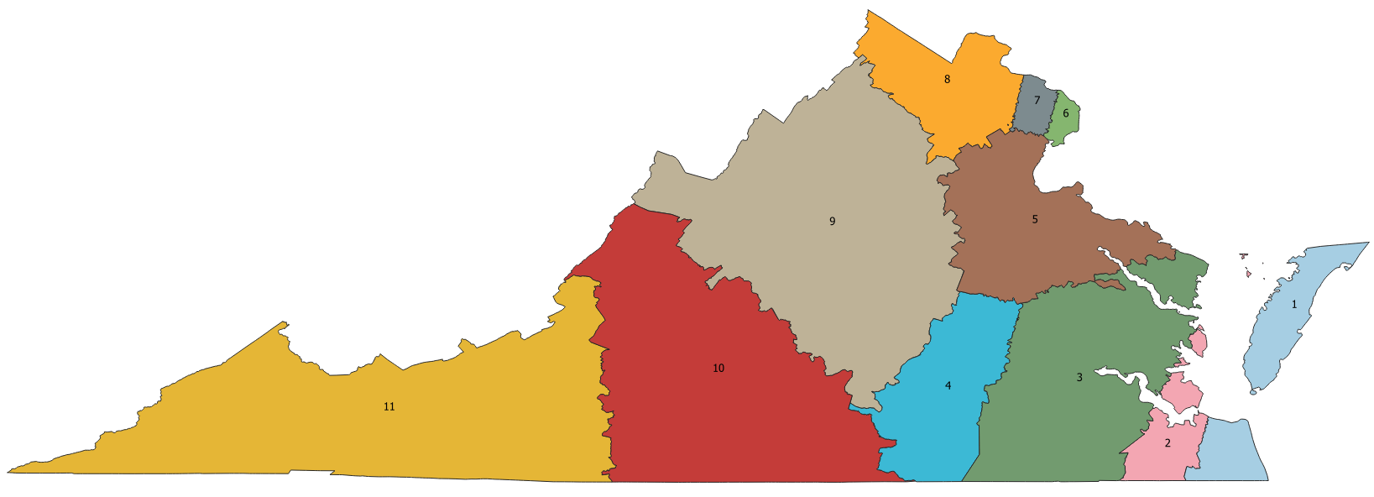
Step 5: Final Output

Slide 20
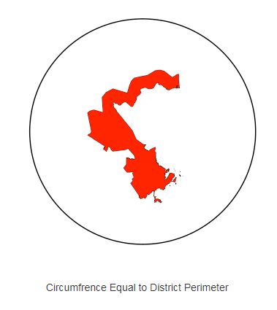

Creating Metrics to Evaluate Maps
I calculated four main metrics for analysis on the maps
Polsby-Popper Score: Calculates the ratio of the area to the area of a circle whose circumference is equal to the perimeter of the district. The score for a circle is 1.
$$PP Score=4π\frac{A_{D}}{P_{D}^{2}}$$

Slide 21
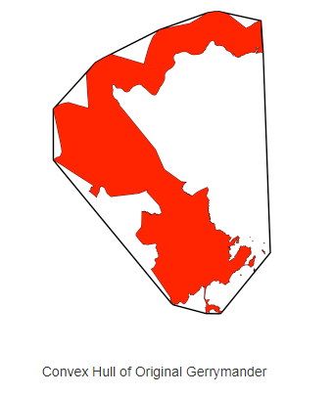

Metrics, Continued
Convex Hull Ratio Score: Calculates the ratio of the area of the shape the area of the shape’s convex hull.
$$CH Score=\frac{A_{D}}{A_{CH\left(D\right)}}$$

Slide 22
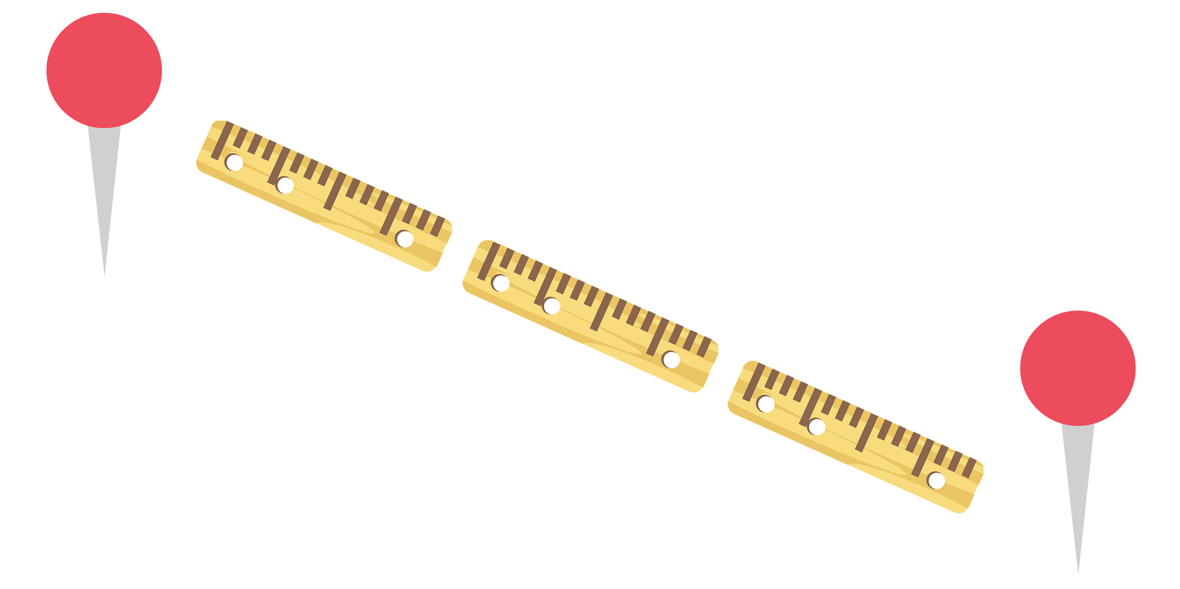

Metrics Continued: Average Distances
Average Distance, Weighted by Population: Determine the average distance to the center of the district, for a typical constituent. Sensitive to population distribution. This is one of Brian Olson’s preferred metric. For the population, $P$, of a region, $D$, and centroid $C\left(D\right)$
$$Avg Distance=\frac{1}{\left|P\right|}\sum_{P}{d\left(p, C\left(D\right)\right)}, where$$
$$p∈P, and d\left(x, y\right) is the distance$$
Average Distance, Geometric: This is just the average distance to the centroid, with all points considered equally. We approximate this using sampling because the general form is somewhat cumbersome.

Slide 23
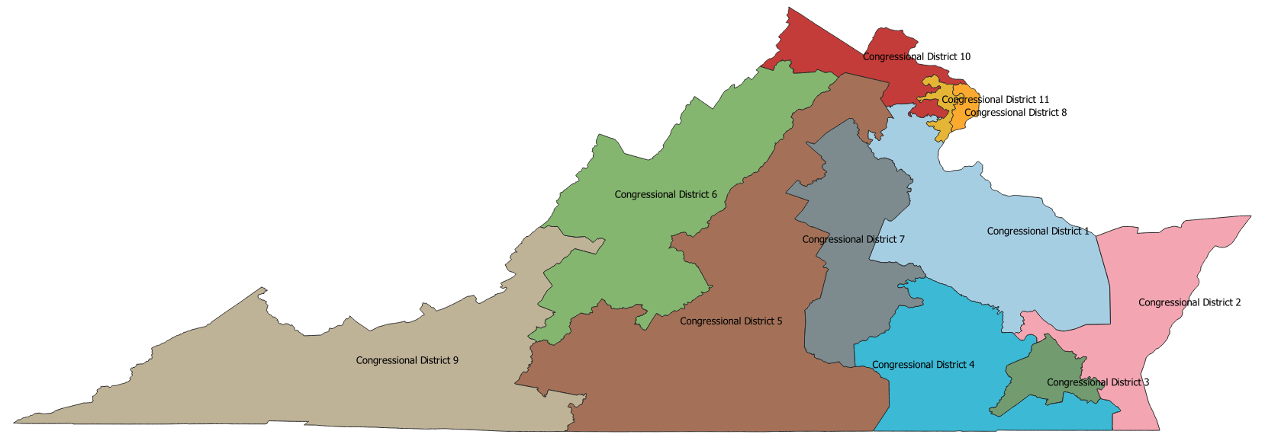
Existing Virginia Congressional Districts

Slide 24
Metrics for Existing Congressional Districts
District Number | Polsby-Popper Score | Convex Hull Ratio | Average Distance (Population) | Average Distance (Approximately Geometric)
1 | 0.228 | 0.754 | 0.657 | 0.478
2 | 0.218 | 0.572 | 0.581 | 0.465
3 | 0.221 | 0.706 | .0242 | .0198
4 | 0.198 | 0.748 | 0.579 | 0.425
5 | 0.147 | 0.652 | 0.839 | 0.771
6 | 0.160 | 0.694 | 0.737 | 0.598
7 | 0.195 | 0.690 | 0.453 | 0.433
8 | 0.263 | 0.803 | 0.081 | 0.086
9 | 0.165 | 0.666 | 0.913 | 0.866
10 | 0.120 | 0.592 | 0.402 | 0.337
11 | 0.092 | 0.527 | 0.121 | 0.125
Average | 0.182 | 0.641 | 0.510 | 0.435

Slide 25
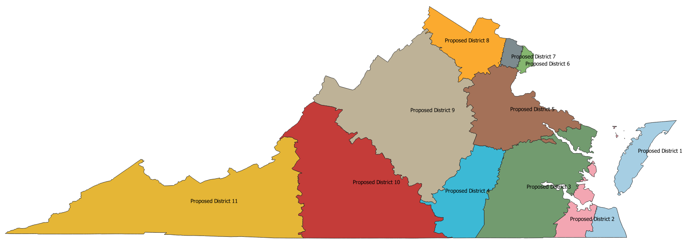
New Virginia Congressional Districts

Slide 26
Metrics for New Congressional Districts
District Number | Polsby-Popper Score | Convex Hull Ratio | Average Distance (Population) | Average Distance (Approximately Geometric)
1 | 0.320 | 0.824 | 0.542 | 0.470
2 | 0.322 | 0.792 | 0.186 | 0.232
3 | 0.214 | 0.878 | 0.443 | 0.464
4 | 0.292 | 0.815 | 0.518 | 0.341
5 | 0.178 | 0.765 | 0.400 | 0.377
6 | 0.344 | 0.834 | 0.077 | 0.086
7 | 0.306 | 0.875 | 0.099 | 0.107
8 | 0.268 | 0.752 | 0.367 | 0.298
9 | 0.243 | 0.825 | 0.467 | 0.593
10 | 0.251 | 0.837 | 0.512 | 0.581
11 | 0.213 | 0.752 | 0.900 | 0.846
Average | 0.268 | 0.788 | 0.410 | 0.400

Slide 27

Challenges, Lessons Learned, and Next Steps
There are a ton of things to know before you can work with GIS data effectively.
There are a ton of different ways to do the same thing.
And there are a lot of places where things can be messed up (corrupt data, inconsistent projections, etc.)
This method produces pretty good results and is very performant. I was happy with the output, but there is still a lot of work to do.
Changes in government happen slowly and introducing functionality like this will take many years. Using maps such as these for a starting point for an independent redistricting commission would probably be a good starting point.
Cleanup Items, other optimizations and analysis.
Revisit average distance

Slide 28

Questions?

